Slide 1
Infotainment and Electronic control module data
Nonprofit Security Grant Program
-Application Process-

Slide 2
Contacts
Contracted Support Team
Application Submission and Astra
Connie Satzler
785-410-0410
csatzler@kansas.net
Paul Peppers
ppeppers@envisageconsult.com
Lieutenant Edna Murphy
Kansas Highway Patrol Consulting
Fiscal/Grant Administration
785-296-2444 (Office)
785-207-0423 (Cell)
Edna.Murphy@ks.gov

Slide 3
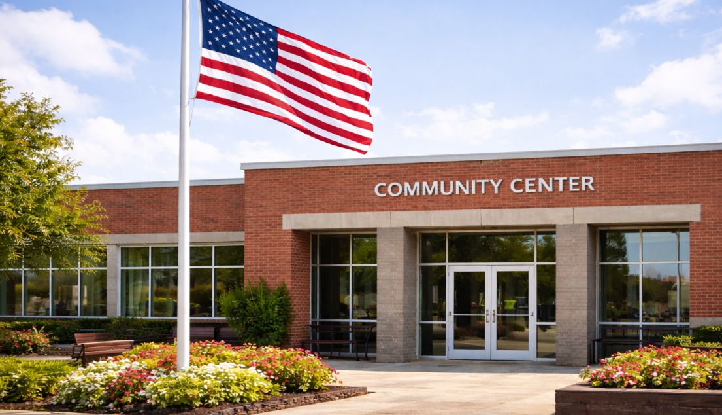
Preview of the State of Kansas Nonprofit Security Grant Program
Overview
Objectives & Priorities
Overview of Application Packet
Risk Assessment
Eligibility
Funding & Guidelines
Allowable Activities & Costs
Unallowable Activities & Costs
Application Packet
Application Lessons Learned

Slide 4

Nonprofit Security Grant Program (NSGP) Overview
The Nonprofit Security Grant Program (NSGP) is funded through the U.S. Department of Homeland Security (DHS) / Federal Emergency Management Agency (FEMA) and is administered by the Kansas Highway Patrol (KHP).
The entity within the KHP responsible for pass-through and oversight of the NSGP is the Fiscal/Grant Administration.
Non-Profit Security Grant Program (NSGP) - provides funding support for physical security enhancements and other security activities to nonprofit organizations that are at substantial risk of a terrorist attack.
These grant programs are part of a comprehensive set of measures authorized by Congress and implemented by the DHS to help strengthen the nation’s communities against potential terrorist attacks.
The performance period for this opportunity is usually 36 months and the SAA will define a specific timeline in an award agreement with your nonprofit.

Slide 5

FEMA – DHS NSGP Goals
The NSGP will improve and increase the physical/cybersecurity and facility/target hardening of nonprofit organizations’ facilities at risk of a terrorist of other extremist attack, ultimately safeguarding the lives and property of the American people.
Concurrently, the NSGP will integrate the preparedness activities of nonprofit organizations that are at high risk of a terrorist or other extremist attack with broader state and local preparedness efforts.

Slide 6
FEMA/DHS’ FY25 Funding Objectives for NSGP
Enhance equipment and conduct security-related activities to improve the security posture of nonprofit organizations that are at high risk of a terrorist or other extremist attack. (Build and sustain core capabilities, as identified in individual nonprofit Vulnerability Assessments.)
Address and close capability gaps identified in Vulnerability Assessments via funding spent on Planning, Equipment, Training and Exercises that aim to enhance the protection of soft targets and crowded places.
Strengthen relationships across nonprofit organizations, state, local, and territorial homeland security agencies for a whole community approach to preparedness

Slide 7
FY26 FEMA NSGP Funding Priorities
National Priority Areas:
Enhancing the Protection of Soft Targets/Crowded Places
Supporting Homeland Security Task Forces and Fusion Centers
Enhancing Cybersecurity
Enhancing Election Security
Supporting Border Crisis Response and Enforcement
Enduring Needs:
Planning
Training & Awareness
Exercises

Slide 8

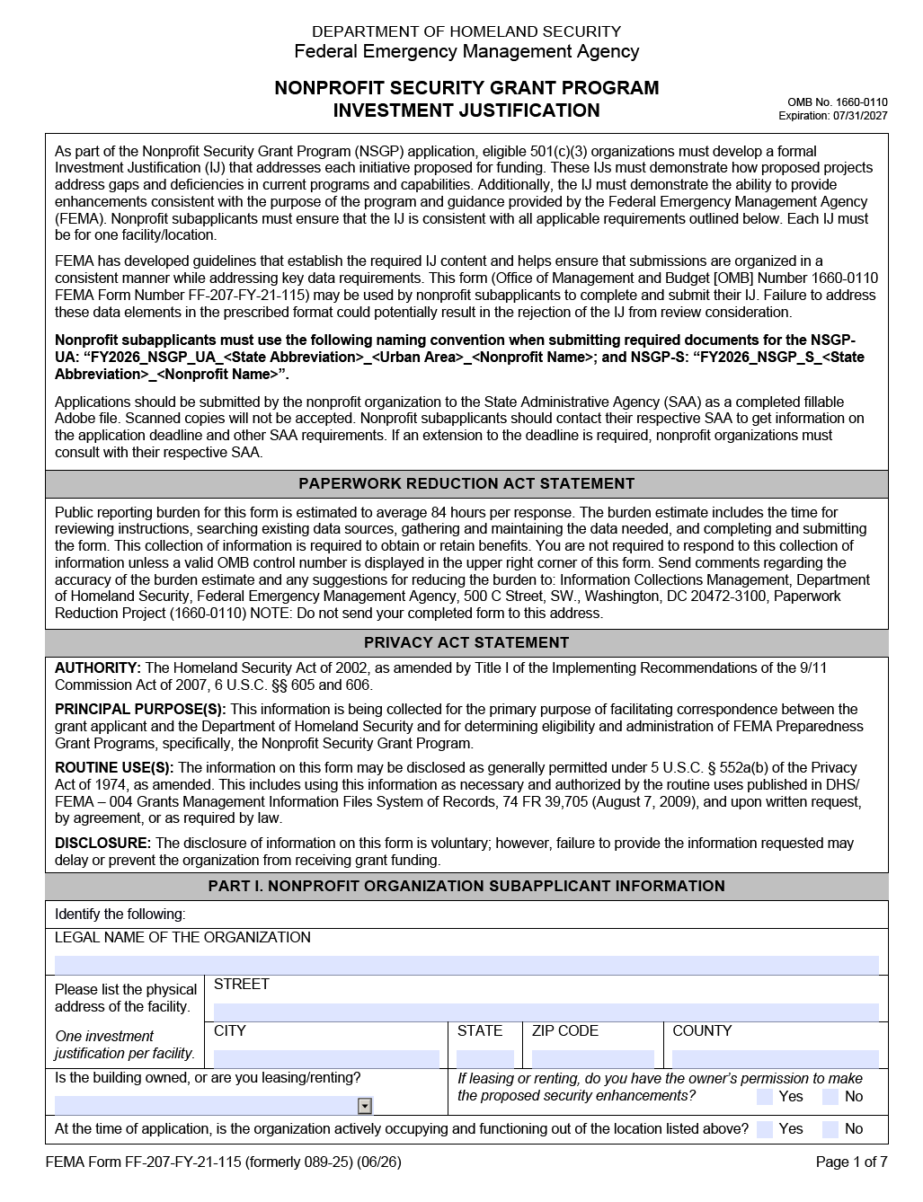
Application Packet- What is Required
Deadline: July 12, 2026
Obtain a Unique Entity Identifier Number (UEI)
  Must be obtained through https://www.sam.gov before submitting your application packet.
Nonprofit. Your organization must be a 501(c) nonprofit.
Complete and submit the following documents:
  a. NSGP Investment Justification (IJ)
    This form is the grant application form. It can be found at https://www.datacounts.net/nsgp.
    All milestones must be between 9/1/2026 and 5/31/2029
  b. Vulnerability/Risk Assessment
  If you haven’t already completed one, you should start now. If you cannot schedule an on-site risk assessment, you can utilize a self-risk assessment or contact us directly for assistance.

Slide 9
Application Packet Overview, Cont.
  c. Mission Statement
  If your organization does not have a mission statement, you will need to create one.
  Other Supporting Information (if necessary) Environmental Planning and Historic Preservation (EHP).
EHP is not required at time of application but required before any physical work can begin on your facility.
Other supporting documents may include;
Police Reports/ articles / logs of activity that supports your need for security enhancements
Security team / working group / council meeting minutes or other record supporting

Slide 10
Vulnerability/Risk Assessment
Assessment options (see datacounts.net/nsgp for links)
Conduct a risk assessment through your local police or sheriff’s department
If you cannot coordinate with trained Law Enforcement to complete an assessment, utilize the DHS Self-Assessment Tool and Supporting Resources for Houses of Worship, the DHS Security Assessment Tool for schools, or the REMS Mobile Site Assessment Application
  Houses of Worship Tool – Can be used and adapted by ANY type of organization
    DHS CISA Houses of Worship Self-Assessment Tool
    Self-Assessment Tool User Guide and Survey
    Protecting Places of Worship: Six Steps to Enhance Security Against Targeted Violence Fact Sheet
    DHS CISA Faith Based Resource Web Site
  School Security Assessment Tool
    DHS School Security Assessment Tool (SSAT)
    REMS Mobile Site Assessment Application

Slide 11

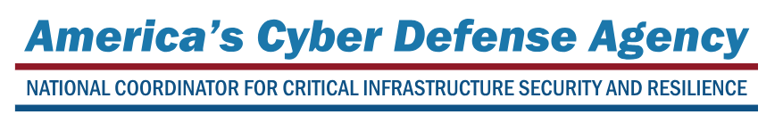
Vulnerability Risk Assessment
Chuck Clanahan, CPP
Protective Security Advisor – Northern Kansas District
Cybersecurity and Infrastructure Security Agency
U.S. Department of Homeland Security
785-213-8699 | chuck.clanahan@cisa.dhs.gov
Tim Morgan
Protective Security Advisor – Southern Kansas District
Cybersecurity and Infrastructure Security Agency
U.S. Department of Homeland Security
620-803-7244 | timothy.morgan@cisa.dhs.gov
https://www.cisa.gov/faith-based-organizations-houses-worship
https://www.cisa.gov/publication/houses-worship-security-self-assessment
https://www.cisa.gov/houses-of-worship

Slide 12

NSGP Eligibility
The SAA is the only entity eligible to apply for NSGP funds on behalf of eligible nonprofit organizations that have been determined to be at high risk of terrorist attack.
Eligible nonprofit organizations are those organizations described under section 501(c)(3) of the Internal Revenue Code of 1986, Title 26 of the U.S.C., and exempt from tax under section 501(a) of such Code.
For NSGP-UA, nonprofit organizations must be located within one of the UASI designated urban areas.
  KC Metro counties of JO, LV, and WY apply through Missouri.
For NSGP-S, nonprofit organizations may be located anywhere within a state or territory, outside of a UASI-designated urban area.
  If you receive any public tax dollars for operation- you are not eligible.

Slide 13
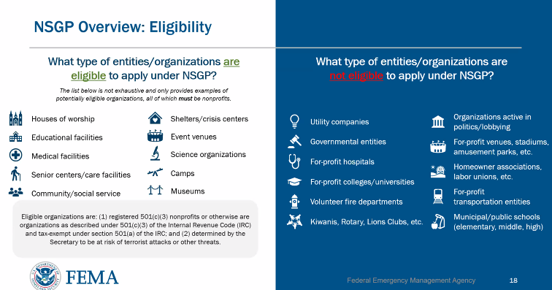
NSGP Eligibility – FEMA Slide

Slide 14
NSGP FY 26 Funding
The total amount of funds under this grant program Nationwide for FY26 is $300 million, $150 million for the State program and $150 million for the Urban Area program.
The expected FY26 total allocation for Kansas nonprofit organizations is $2,137,500.
For NSGP-S, the SAA may and has determined an award cap for individual subawards up to a maximum of $150,000 per applicant (per facility with individual address), not to exceed $450,000 per organization.
This cap allows more nonprofits to compete for funds for security enhancements.
Please do not simply apply for the maximum amount “just because”. All funding needs must be justified, and you must be able to complete all activities within a designated performance period set by the SAA.
Ultimately, FEMA/DHS can award up to $150,000 per applicant.
  You can list out and justify a need for more funding in the narrative portion of your IJ, but your funding request cannot exceed the KS cap of $150,000. The listed expenses in the 2nd portion of the Target Hardening (where AEL #’s are listed must equal the requested amount)

Slide 15

NSGP Funding Guidelines
NSGP allowable costs are focused on security-related activities.
Funding can be used for
  contracted security personnel
  security-related planning
  security-related exercises
  security-related training
  and the acquisition and installation of security equipment on real property (including buildings and improvements) owned or leased by the nonprofit organization at the time of application.
  Note: funds are not for cosmetic improvements, they must be specific to security enhancements. FEMA closely scrutinized project descriptions and will place financial holds where it is not clear.
  Landscaping is not an allowable cost- even if you believe it increases security- talk to the SAA for clarification.
  Funding is not meant for long term dependency and meant to increase self-reliance.
  Nonprofits should plan for future self-sustainment.

Slide 16
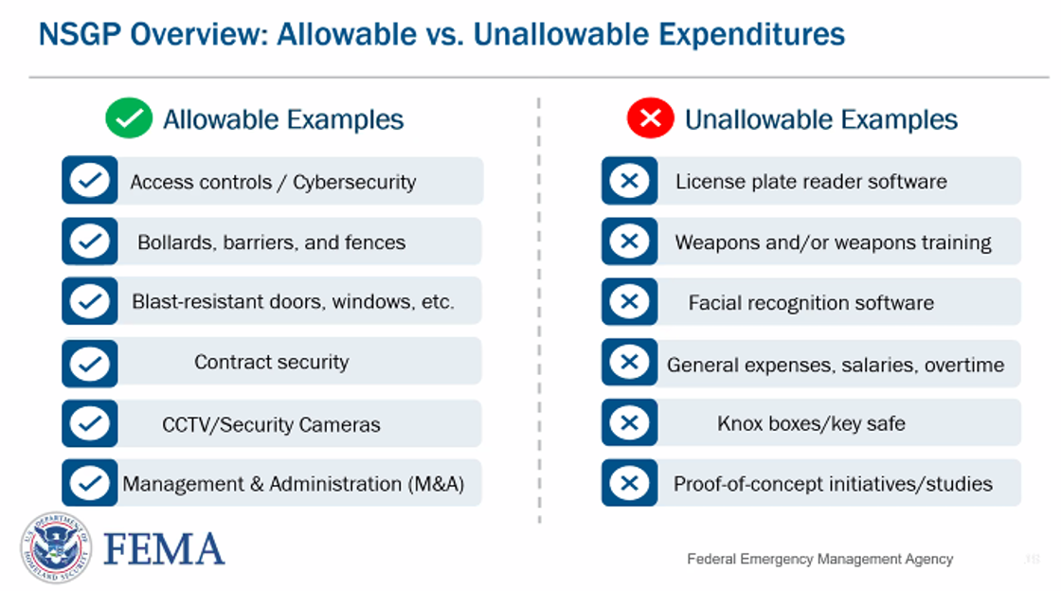
FEMA Slide

Slide 17

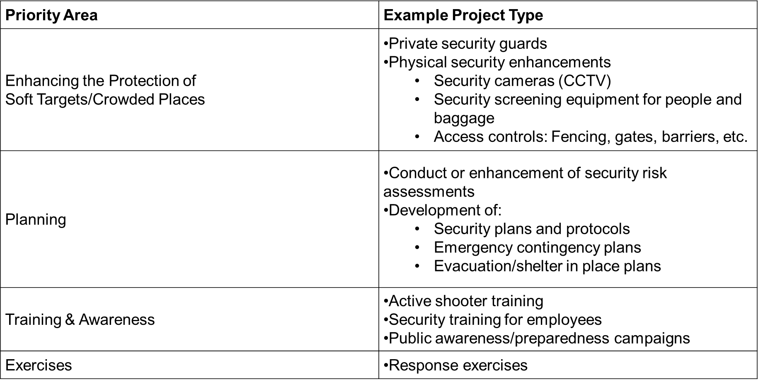
Priority Examples – see NOFO for more examples

Slide 18

Proposed Activities are limited to:
1. Planning Costs: Security or emergency planning expenses and the materials utilized to conduct planning activities. Planning must be related to the protection of the facility and the people within the facility and should include people with access and functional needs as well as those with limited English proficiency.
2. Exercise Costs: Conduct security-related exercises. This includes costs related to planning, meeting space and other meeting costs, facilitation costs, materials and supplies, and documentation. See the FEMA Preparedness Grants Manual for more information.
3. Training Costs: Costs for training of security personnel are permitted. Allowable training topics are limited to the protection of critical infrastructure and key resources, including physical and cybersecurity, target hardening, and terrorism awareness/employee preparedness. Training conducted using NU-NSGP funds must address a specific threat and/or vulnerability, as identified in the nonprofit organization’s investment justification (IJ). See the FEMA Preparedness Grants Manual for more information.
4. Equipment: Authorized Equipment List (AEL) Physical Security Enhancement Equipment (Category 14) and Inspection and Screening Systems (Category 15). For more information regarding property management standards for equipment, please reference 2 C.F.R. § 200.313, located on the Electronic Code of Federal Regulations. 5. Maintenance and Sustainment Costs: Maintenance, contracts, warranties, repair or replacement costs, upgrades, and user fees as described in FP 205-402-125-1 Maintenance Contracts and Warranty Coverage Funded by Preparedness Grants.
5. Maintenance and Sustainment Costs: Maintenance, contracts, warranties, repair or replacement costs, upgrades, and user fees as described in FP 205-402-125-1 Maintenance Contracts and Warranty Coverage Funded by Preparedness Grants.

Slide 19

Allowable Costs
  Management and Administration (M&A) M&A activities are those costs defined as directly relating to the management and administration of NSGP funds, such as financial management and monitoring. The amount of M&A is specified in each fiscal year’s NSGP NOFO. M&A costs include the following categories of activities:
  Hiring of full-time or part-time staff or contractors/consultants responsible for activities relating to the management and administration of NSGP funds.
  Meeting-related expenses directly related to M&A of NSGP funds Indirect (Facilities and Administrative [F&A]) Costs.
  Note: These must be listed in the IJ and Pre-Approved
  Indirect costs are allowable under this program as described in 2 C.F.R. Part 200, including 2 C.F.R. § 200.414. Applicants with a negotiated indirect cost rate agreement that desire to charge indirect costs to an award must provide a copy of their negotiated indirect cost rate agreement at the time of application.
  Applicants that are not required by 2 C.F.R. Part 200 to have a negotiated indirect cost rate agreement but are required by 2 C.F.R. Part 200 to develop an indirect cost rate proposal must provide a copy of their proposal at the time of application.
  Post-award requests to charge indirect costs will be considered on a case-by-case basis and based upon the submission of an agreement or proposal.

Slide 20
Allowable Direct Costs- Planning
Funding may be used for security or emergency planning expenses and the materials required to conduct planning activities.
Planning must be related to the protection of the facility and the people within the facility and should include consideration of access and functional needs as well as those with limited English proficiency.
Examples of planning activities allowable under this program include:
Development and enhancement of security plans and protocols
Development or further strengthening of security assessments
Emergency contingency plans
Evacuation/Shelter-in-place plans
Other project planning activities with prior approval from DHS/FEMA

Slide 21
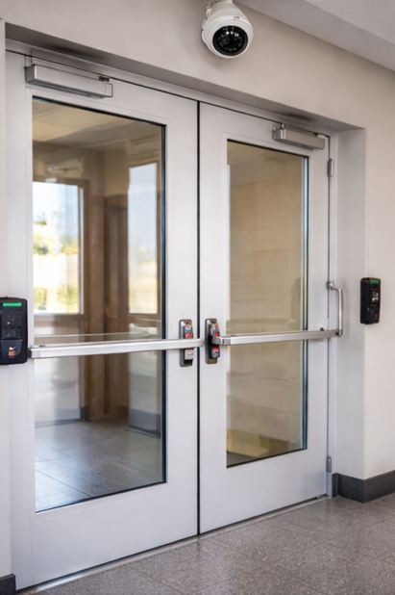
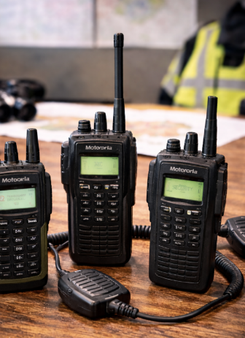
Allowable Direct Costs- Equipment
Allowable costs are focused on target hardening and physical security enhancements.
Funding can be used for the acquisition and installation of security equipment on real property (including buildings and improvements) owned or leased by the nonprofit organization, specifically in prevention of and/or protection against the risk of a terrorist attack.
This equipment is limited to select items in the following two sections of items on the Authorized Equipment List (AEL):
* Physical Security Enhancement Equipment (Section 14) Portable radios
* Inspection and Screening Systems (Section 15) Public warning & notification
The two allowable prevention and protection categories and equipment standards for the NSGP are listed on DHS AEL located on the DHS/FEMA site at http://www.fema.gov/authorized-equipment-list .
Unless otherwise stated, equipment must meet all mandatory statutory, regulatory, and DHS/FEMA-adopted standards to be eligible for purchase using these funds, including the Americans with Disabilities Act.
In addition, recipients will be responsible for obtaining and maintaining all necessary certifications and licenses for the requested equipment. Applicants should analyze the cost benefits of purchasing versus leasing equipment, especially high-cost items and those subject to rapid technical advances. Large equipment purchases must be identified and explained. For more information regarding property management standards for equipment, please reference 2 C.F.R. Part 200, including but not limited to 2 C.F.R. §§ 200.310, 200.313, and 200.316.

Slide 22
AELCode | Title | Description
14CI-00-COOP | System, Information Technology Contingency Operations | Back-up computer hardware, operating systems, data storage, and application software necessary to provide a working environment for contingency operations. May be a purchased remote service or a dedicated alternate operating site.
14EX-00-BCAN | Receptacles, Trash, Blast-Resistant | Blast-resistant trash receptacles.
14EX-00-BSIR | Systems, Building, Blast/Shock/Impact Resistant | Systems to mitigate damage from blasts, shocks, or impacts, such as column and surface wraps, wall coverings, breakage/shatter resistant glass, window wraps, and deflection shields.
14SW-01-ALRM | Systems/Sensors, Alarm | Systems and standalone sensors designed to detect access violations or intrusions using sensors such as door/window switches, motion sensors, acoustic sensors, seismic, and thermal sensors. May also include temperature sensors for critical areas.
14SW-01-DOOR | Doors and Gates, Impact Resistant | Reinforced doors and gates with increased resistance to external impact for increased physical security.
14SW-01-EXTM | System, Fire Extinguisher Monitoring | System for monitoring the presence and pressure of fixed-location fire extinguishers to ensure that they are usable and are not stolen for possible misuse.
14SW-01-LITE | Lighting, Area, Fixed | Fixed high-intensity lighting systems for improved visibility in areas such as building perimeters and surveillance zones.
14SW-01-PACS | System, Physical Access Control | Locking devices and entry systems for control of physical access to facilities.

Slide 23
AELCode | Title | Description
14SW-01-SIDP | Systems, Personnel Identification | Systems for positive identification of personnel as a prerequisite for entering restricted areas or accessing information systems.
14SW-01-SIDV | Systems, Vehicle Identification | Systems for identification of vehicles, ranging from decals to radio frequency identification (RFID) or other transponder devices.
14SW-01-SNSR | Sensors/Alarms, System & Infrastructure Monitoring, Standalone | Standalone sensors/alarms for use on critical systems or infrastructure items (security systems, power supplies, etc.) to provide warning when these systems fail or are near failure.
14SW-01-VIDA | Systems, Video Assessment, Security | Camera-based security systems utilizing standard, low light, or infrared technology.
14SW-01-WALL | Barriers: Fences; Jersey Walls | Obstacles designed to channel or halt pedestrian or vehicle-borne traffic in order to protect a physical asset or facility.
14SW-02-HSCN | Equipment, Hull Scanning | Devices or systems used to scan ship hulls for attached devices.
14SW-02-RADR | Systems, Radar | Scanning systems for detection of objects such as vessels, personnel, and other objects.
14SW-02-SONR | Systems, Sonar | Includes several different types of underwater sound wave imaging: Imaging Sonar: A high-frequency sonar that produces video-like imagery using a narrow field of view. The sonar system can be pole-mounted over the side of a craft or hand-carried by a diver. Scanning Sonar: Consists of smaller sonar systems that can be mounted on tripods and lowered to the bottom of the waterway. Scanning sonar produces a panoramic view of the surrounding area and can cover up to 360 degrees. Side Scan Sonar: Placed inside of a shell and towed behind a vessel. Side scan sonar produces strip-like images from both sides of the device. 3-Dimensional Sonar: Produces 3-dimensional imagery of objects using an array receiver.

Slide 24
AELCode | Title | Description
14SW-02-VBAR | Barriers, Vessel | Deployable, modular systems for restricting the movement of vessels.
15IN-00-PLSN | System, Pulsed Neutron Activation, Non-Invasive | Screening system utilizing pulsed neutrons. Non-destructive detection of CWAs in sealed containers.
15IN-00-RADR | Radar, Ground/Wall Penetrating | Radar systems designed to penetrate walls or ground to allow detection of hidden objects.
15IN-00-XRAY | System, Mobile Search & Inspection; X-Ray | Portable X-Ray systems for use in search and screening operations.
15SC-00-PMON | Monitors, Portal | Systems to scan vehicles/cargo for radioactive content. Various sizes for vehicles, packages (large and small) and pedestrians. Does not identify radionuclide. Note: For explosive detection portal, see Item 07ED-03-PORT. DIQCode: [D,Q]
15SC-00-PPSS | Systems, Personnel/Package Screening | Hand-held or fixed systems such as walk-through magnetometers and conveyor-belt x-ray systems used to screen personnel and packages for hazardous materials/devices.

Slide 25

Allowable Direct Costs- Construction and Renovation
NSGP funding may not be used for construction and renovation projects without prior written approval from DHS/FEMA.
All recipients of NSGP funds must request and receive prior approval from DHS/FEMA before any NSGP funds are used for any construction or renovation.
Additionally, recipients are required to submit a SF-424C Budget and budget detail citing the project costs.
The total cost of any construction or renovation paid for using NSGP funds may not exceed the greater amount of $100,000 or 15% of the NSGP award.
Recipients and subrecipients are also encouraged to have completed as many steps as possible for a successful EHP review in support of their proposal for funding (e.g., coordination with their State Historic Preservation Office to identify potential historic preservation issues and to discuss the potential for project effects, compliance with all State and EHP laws and requirements).
Projects for which the recipient believes an Environmental Assessment (EA) may be needed, as defined in DHS Instruction Manual 023-01-001-01, Revision 01, FEMA Directive 108-1, and FEMA Instruction 108-1-1, must also be identified to the FEMA HQ Program Analyst within six months of the award and completed EHP review materials must be submitted no later than 12 months before the end of the period of performance. EHP review packets should be sent to edna.murphy@ks.gov and carbon copy NSGP.KHP@KS.GOV , so your EHP can be submitted to FEMA on your behalf.
Note: Compliance requirements

Slide 26
Allowable Direct Costs- Maintenance and Sustainment
The use of DHS/FEMA preparedness grant funds are allowable for;
maintenance contracts,
warranties,
repair or replacement costs,
upgrades, and
Maintenance Contracts and Warranty Coverage Funded by Preparedness Grants, located at http://www.fema.gov/media-library/assets/documents/32474, under all active and future grant awards, unless otherwise noted.
Grant funds are intended to support the National Preparedness Goal and fund projects that build and sustain the core capabilities necessary to prevent, protect against, mitigate the effects of, respond to, and recover from those threats that pose the greatest risk to the security of the Nation.
Eligible maintenance and sustainment costs must be;
In direct support of existing capabilities,
must be an otherwise allowable expenditure under the applicable grant program, and
be tied to one of the core capabilities in the five mission areas outlined in the Goal. Additionally, eligible costs may also support equipment, training, and critical resources that have previously been purchased with either federal grant or any other source of funding other than DHS/FEMA preparedness grant program dollars.

Slide 27
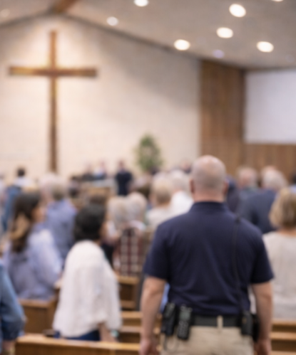
Allowable Direct Costs- Contracted Security Personnel
Contracted security personnel are allowed under this program only as described in the NOFO and Manual and comply with guidance set forth in IB 421b and IB 441.
NSGP funds may not be used to purchase equipment for contracted security.
The recipient must be able to sustain this capability in future years without NSGP funding.
Important: If you plan to use more than 50% of your award for personnel costs, an additional step of requesting a waiver through FEMA is required.
Note: Nonprofits should not plan for long-term sustainment and plan to absorb future costs.

Slide 28

Allowable Direct Costs- Training
Nonprofit organizations may use NSGP funds for the following training-related costs:
Employed or volunteer security staff to attend security-related training within the United States;
Employed or volunteer staff to attend security-related training within the United States with the intent of training other employees or members/congregants upon completing the training (i.e., “train-the-trainer” type courses)
Nonprofit organization’s employees, or members/congregants to receive on-site security training.
Allowable training-related costs under the NSGP are limited to attendance fees for training and related expenses, such as materials, supplies, and/or equipment.
Overtime, backfill, and travel expenses are not allowable costs.
Allowable training topics are limited to the protection of critical infrastructure key resources, including physical and cybersecurity, target hardening, and terrorism awareness/employee preparedness such as Community Emergency Response Team (CERT) training, Active Shooter training, and emergency first aid training.
Training conducted using NSGP funds must address a specific threat and/or vulnerability, as identified in the nonprofit organization’s IJ.
Training should provide the opportunity to demonstrate and validate skills learned as well as to identify any gaps in these skills.
Proposed attendance at training courses and all associated costs using the NSGP must be included in the nonprofit organization’s IJ.

Slide 29
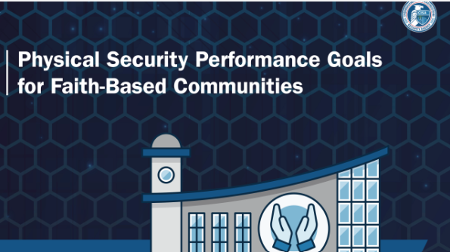

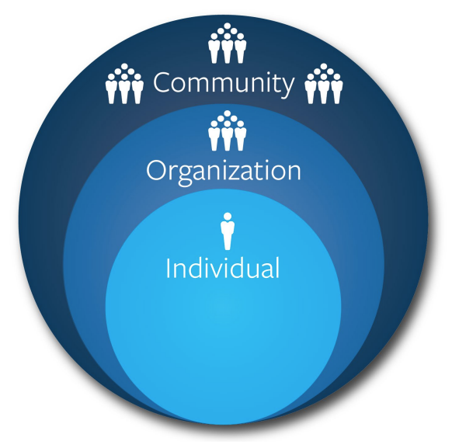
Training Resources
https://www.cisa.gov/resources-tools/training
https://www.cisa.gov/topics/physical-security/active-shooter-preparedness
https://www.cisa.gov/topics/physical-security/protecting-houses-worship
https://www.cisa.gov/topics/physical-security/bombing-prevention
https://www.cisa.gov/topics/physical-security/insider-threat-mitigation
https://www.cisa.gov/topics/physical-security/securing-public-gatherings

Slide 30
Allowable Direct Costs- Exercises
Funding may be used to conduct security-related exercises. This includes costs related to planning, meeting space and other meeting costs, facilitation costs, materials and supplies, and documentation.
Exercises afford organizations the opportunity to validate plans and procedures, evaluate capabilities, and assess progress toward meeting capability targets in a controlled, low-risk setting.
All shortcomings or gaps—including those identified for children and individuals with access and functional needs—should be identified in an improvement plan.
Improvement plans should be dynamic documents with corrective actions continually monitored and implemented as part of improving preparedness through the exercise cycle.
The Homeland Security Exercise and Evaluation Program (HSEEP) provides a set of guiding principles for exercise programs, as well as a common approach to exercise program management, design and development, conduct, evaluation, and improvement planning.
For additional information on HSEEP, NSGP Appendix | February 2020 Page C-3 refer to https://www.fema.gov/exercise.

Slide 31
Unallowable Costs
The following projects and costs are considered ineligible for award consideration:
Organization costs, and operational overtime costs
Hiring of public safety personnel
General-use expenditures
Overtime and backfill
Initiatives that do not address the implementation of programs/initiatives to build prevention and protection-focused capabilities directed at identified facilities and/or the surrounding communities
The development of risk/vulnerability assessment models
Initiatives that fund risk or vulnerability security assessments or the development of the IJ
Initiatives in which federal agencies are the beneficiary or that enhance federal property
Initiatives which study technology development
Proof-of-concept initiatives
Initiatives that duplicate capabilities being provided by the Federal Government
Organizational operating expenses
Reimbursement of pre-award security expenses

Slide 32
Application Packet– what is required?
Review:
1. Obtain a Unique Entity Identifier (UEI)
  Must be obtained at sam.gov before submitting your application packet
2. Complete the Following Documents:
  NSGP Investment Justification (IJ)
      This form can be found at DataCounts
      All milestones must be between 9/1/2026 and 5/31/2029
  Vulnerability/Risk Assessment
      If you cannot schedule an on-site risk assessment, you can utilize a self risk assessment, or contact us directly for assistance

Slide 33
Application Packet– Continued
  Mission Statement
      If you do not have a mission statement, you will need to create one
  Other Supporting Information (if necessary) Environmental Planning and Historic Preservation (EHP).
EHP is not required at time of application but required before any physical work can begin on your facility.
Other supporting documents may include;
Police Reports/ articles / logs of activity that supports your need for security enhancements
Security team / working group / council meeting minutes or other record supporting

Slide 34
Walk Through IJ

Slide 35
Application lessons learned
  Review the scoring matrix to give you an edge https://www.datacounts.net/nsgp/documents/FY22/FY22%20NSGP%20Scoring%20Matrix_FINAL.pdf
  Read the directions on the IJ completely
  Fill in each section
  Do not copy and paste duplicate projects – make sure each facility stands out from each other
  Double check your math equals the requested amount
  Only list allowable items
  Make sure milestones are reasonable and list key actions that receive a score, such as “Environment Historic Preservation (EHP) approval”.
  Detail your facility vulnerabilities and Priorities (Target Hardening)
  If you can fit under more than one org. type, use the one that has the highest multiplier
  Enter your zip + 4.
  Review before submitting your packet
  Name your file correctly. File name if my org name is Kansas Ad Astra: FY2026_NSGP_S_KS_Kansas Ad Astra
  If you have questions, go to http://www.datacounts.net/nsgp or reach out and ask NSGP.KHP@KS.GOV

Slide 36
Contacts
Submission Notes and Deadlines
  All milestones must be between 9/1/2029 and 5/31/2026
  Due to this year’s timeline, the SAA Team will NOT have time to reach back for any corrections.
  All applications will be submitted AS IS.
  How to submit:
    Upload IJ, Vulnerability/Risk Assessment, and Mission Statement to Astra Portal
    Deadline: July 12 (end of day)
Lieutenant Edna Murphy K-299
KHP – Fiscal / Grant Administration
122 SW 7th Street, Topeka, KS 66603-3847
(785) 207-0423 (Cell)
Edna.murphy@ks.gov
NSGP.KHP@KS.GOV
Contracted Support Team
Connie Satzler Paul Peppers
TA & Grant Support Technical Support
785-410-0410 (Cell) ppeppers@envisageconsult.com
csatzler@kansas.net infotech@envisageconsult.com

Slide 37
Questions?
Notes:
Excessive speeding provisions under reckless driving statutes would establish a level (+35 MPH above posted limit or 105 MPH) of evidence that becomes a prima facie case for reckless driving. Similar to .08 in a DUI, it doesn’t matter how defective the driving is - if the individuals conduct meets the evidentiary threshold, it is presumed reckless.
KHP will continue to work with stakeholders to determine suitable penalties.

Slide 38
Extra slides

Slide 39




Other Resources
To receive future announcements and submit applications, register at https://astrakansas.com/nsgp
To view previous recorded webinars, tools, forms and guidance, go to https://www.Datacounts.net/nsgp
For additional questions, please email the KHP grant team at nsgp.khp@ks.gov .
To register for a UEI go to www.sam.gov

Slide 40
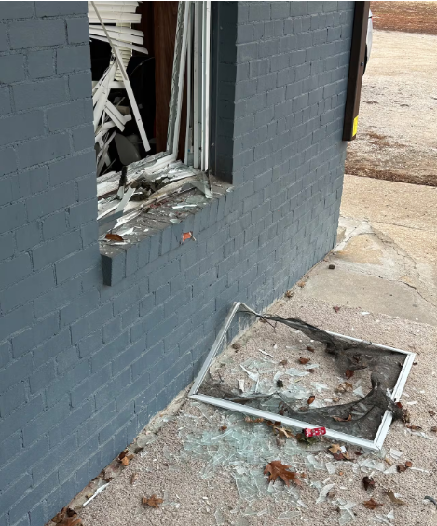
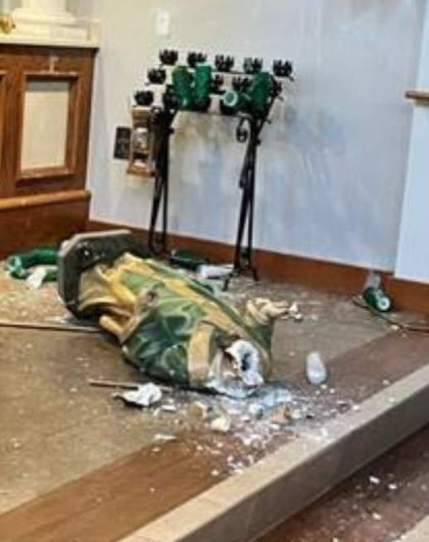
Lessons learned from real world events
KCK church damaged by explosive device, congregation seeking answers
  https://www.kctv5.com/2025/12/31/kck-church-damaged-by-explosive-device-congregation-seeking-answers/
  KANSAS CITY, Kan. (KCTV) - Members of a Kansas City, Kansas, church are picking up the pieces — quite literally — after someone intentionally shattered one of their windows with an explosive device early Sunday morning.
Clash on Capitol lawn centers on ideas of faith, but satanists get arrested inside the rotunda
  https://kansasreflector.com/2025/03/28/loud-boisterous-rival-protests-of-religious-freedom-among-catholics-and-satanists-turn-violent/
Satanic Message Found at Vandalized Catholic Church in Kansas
  https://persecution.org/2025/03/19/satanic-message-found-at-vandalized-catholic-church-in-kansas/
Church fires in Topeka, one wants to press charges
  https://www.ksnt.com/video/church-fires-in-topeka-one-wants-to-press-charges/9446214/
  Two Topeka churches had property intentionally set on fire last night.
Church Attack - Vandals hit Wyandotte County church with hate crime
  https://www.facebook.com/sharonchentv/videos/church-attack-vandals-hit-wyandotte-county-church-with-hate-crime/828110326764678/

Slide 41
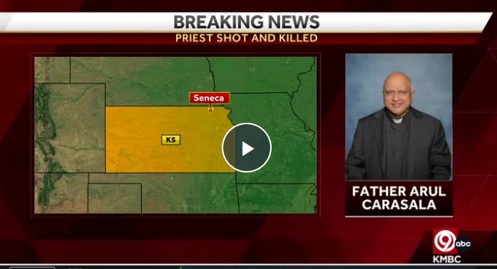
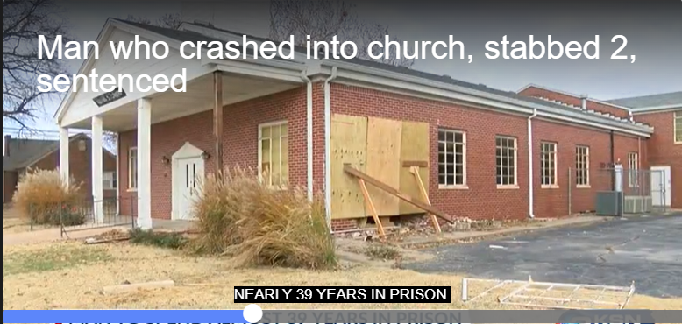
Lessons learned from real world events
Staff member under investigation no longer employed at Leawood Catholic school
  https://www.kctv5.com/2026/02/20/staff-member-under-investigation-no-longer-employed-leawood-catholic-school/
Kansas Catholic priest Father Arul Carasala fatally shot; Suspect arrested in 'senseless act of violence’
  https://www.kmbc.com/article/father-arul-carasala-priest-fatally-shot-seneca-kansas/64381885
Wichita church plagued by break-ins
  https://www.kwch.com/video/2025/02/13/wichita-church-plagued-by-break-ins/
Woman found competent to be tried for fatal stabbing of Topekan, 92
  https://www.cjonline.com/story/news/crime/2025/10/22/woman-found-competent-to-stand-trial-in-stabbing-death-of-topekan-92/86823748007/?gnt-cfr=1&gca-cat=p&gca-uir=true&gca-epti=z11xx89p115850c115850v11xx89b00xxxxd11xx65&gca-ft=175&gca-ds=sophi
  Stabbing death of a 92-year-old woman outside a southeast Topeka church
South KC church member stabbed in chest on Sunday by homeless man
  https://www.jacksoncountyprosecutor.com/m/newsflash/home/detail/1586
Man, who crashed into church, stabbed 2, sentenced
  https://www.ksn.com/news/crime/man-who-crashed-into-church-stabbed-2-sentenced/

Slide 42
Application Packet– what is required?
Overview of Application Packet
1. Obtain a Unique Entity Identifier (UEI)
  Must be obtained at sam.gov (Must have a # to receive funding)
2. Complete the Following Documents:
  NSGP Investment Justification (IJ)
      This form can be found at DataCounts
  Vulnerability/Risk Assessment
      If you cannot schedule an on-site risk assessment, you can utilize a self risk assessment, or contact us directly for assistance
  Mission Statement
      If you do not have a mission statement, you will need to create one

